Slide 1


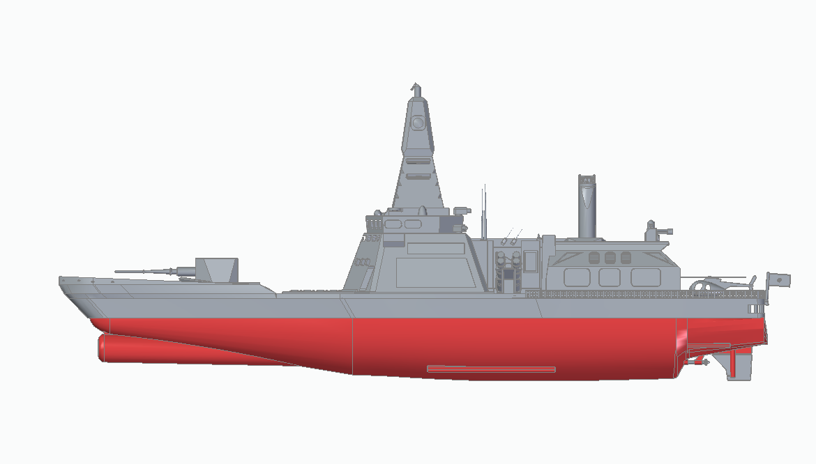
ID1054
- Haritha .R (AI20BTECH11010)

Slide 2
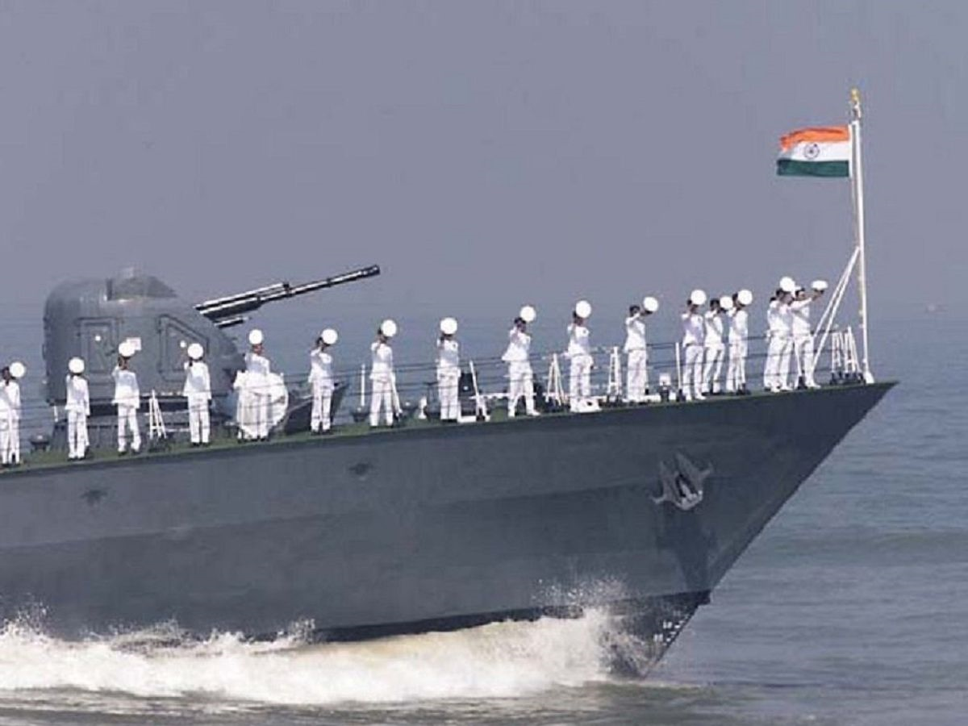
Motivation
Indian Army, Indian Airforce and Indian Navy dedicate their lives to protecting our country. The armed forces inspired us and we decided to make a model based on some equipment they use.
The Indian Navy ships play a pivotal role in battles and help the navy personnel in keeping our country safe.

Slide 3
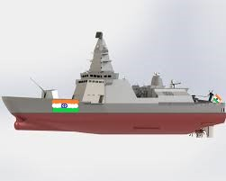
About the model
Destroyer is a fast, maneuverable, long-endurance warship intended to escort larger vessels in a fleet, convoy or battle group and defend them against powerful short range attackers.
We made a model of a destroyer taking inspiration from the navy ships.

Slide 4
Salient Features
This is a design of an Aviation-capable naval vessel. It includes :
Helicopter Hangar-This hangar comes into operation especially on ships used for military purposes. With it a part of the deck can be used to shelter the helicopters.
Ram launcher-It is a guided missile weapon system which is the world's most modern ship self-defense weapon.
Harpoon-The Harpoon is an all-weather, over-the-horizon, anti-ship missile

Slide 5
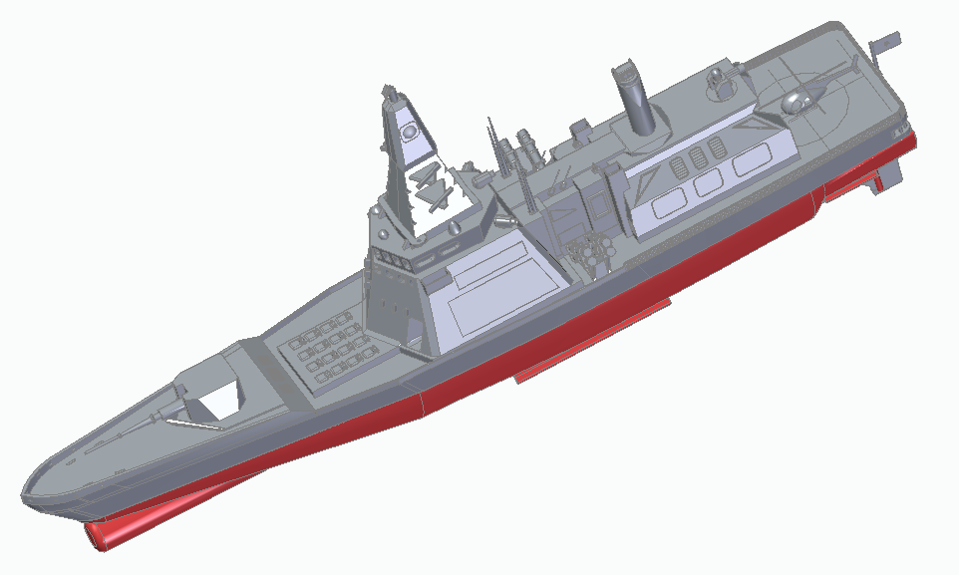
Salient Features

Slide 6
Learnings
We learnt to overcome the challenges faced when creating a 3d model and implementing it practically.
We discovered the nuances involved in making certain details of models and how symmetry can help us simplify the process.
We learnt to be cautious when deciding the clearances, thickness, etc.
We divided the work amongst ourselves and worked on the parts separately and finally assembled all the parts together.
We learnt how to create new designs and replicate certain existing complex designs.
Overall, it was a great learning experience.

Slide 7
Optimisation
We eliminated small parts and loosely hanging features.
We tried to make few parts hollow to reduce the material required and decrease the printing time.
A few complex designs were included in our model which makes cad modelling the best software to use for making it.
The best orientation such that support material is minimised was chosen.

Slide 8
3D printing Data
Settings:
Conversion tolerance-0.01
Surface plane angle-45 degrees
Printing Time estimate:
Mojo- 5hr 16 min
Material(Model/support) estimate:
Mojo
Model material-32.7cm^3
Support material- 12.4cm^3

Slide 9
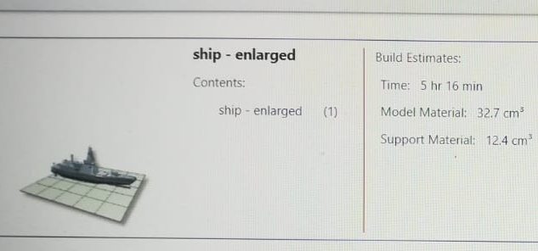
3D printing Data

Slide 10
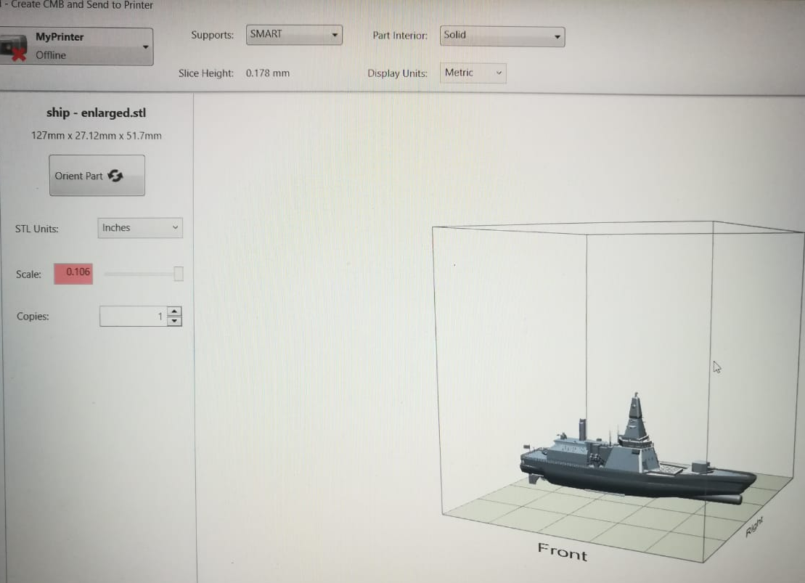
3D printing Data

